Slide 1
Trie project visualization

Slide 2
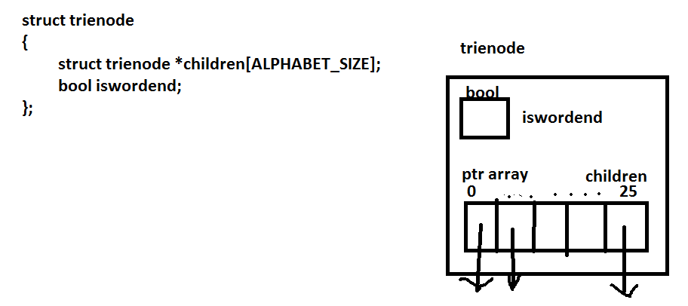
Page 1

Slide 3
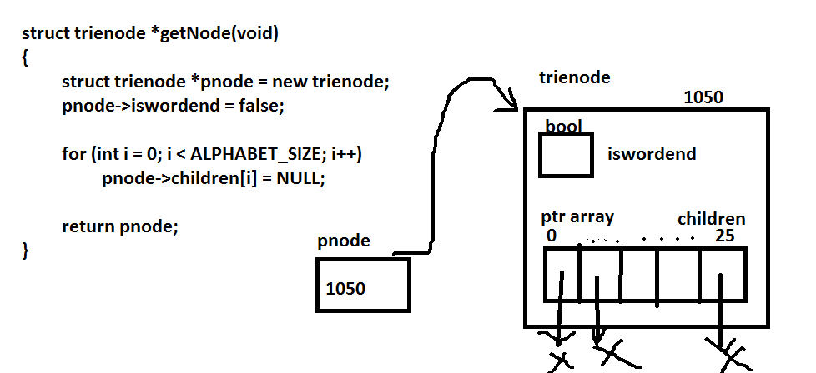
Page 2

Slide 4
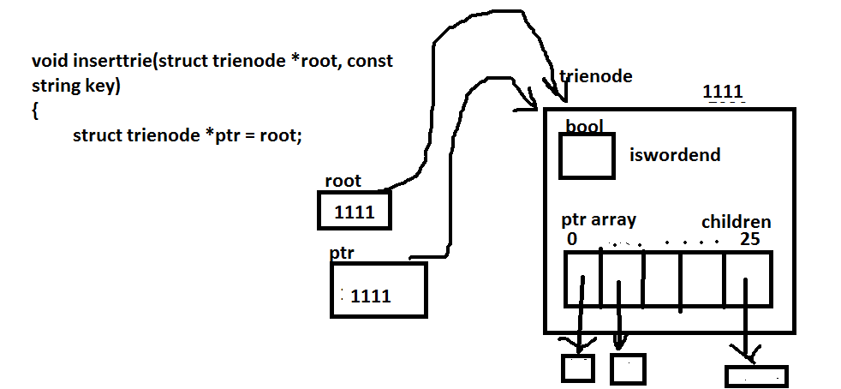
Page 3 part 1

Slide 5
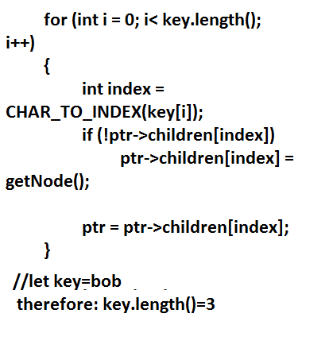
Part 2

Slide 6
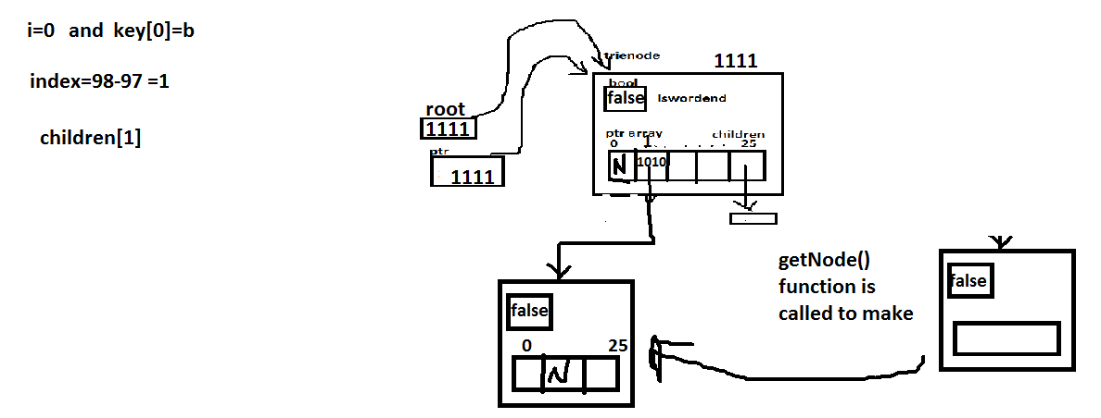
Part 3

Slide 7

Page 4

Slide 8
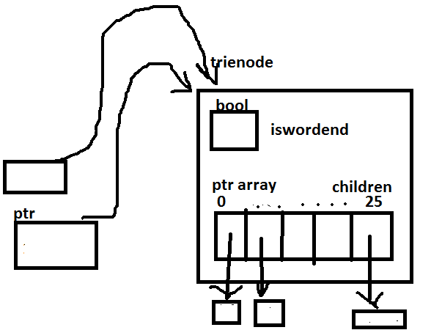
rough

